Slide 1
Containerization
SE489: DevOps Engineering

Slide 2
Outline
Containerization?
Why we need Containers?
Why we need Docker?
What is Docker?
Docker Example
Docker Case Study
Docker Components

Slide 3

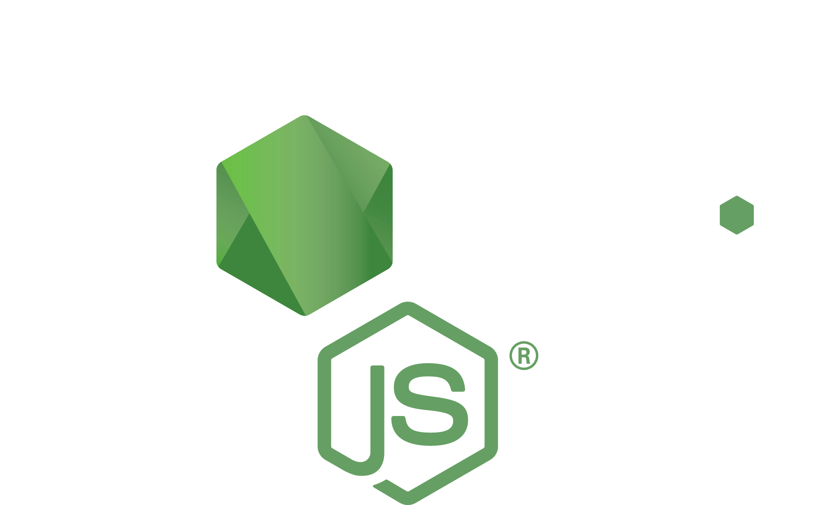


Applications aren’t just code, they have dependencies
Code packages
Operating system packages
Code
Runtime

Slide 4

Containers turn applications into one deployable artifact
Runtime
Code packages
Operating system packages
Code
Container image

Slide 5


Build
Gather the app and its dependencies. Create an immutable container image.
Push
Store the container image in a registry so it can be downloaded to compute
Run
Download image to compute, unpack it, and run it in an isolated environment

Slide 6

Breaking a monolith is scary because more services mean more dependencies
Service A
Service B
Code packages
Code
Code
PyPi packages
Operating system packages
Operating system packages
Node: 16.6.2
Python: 3.9.6

Slide 7

Containers make dependencies a decentralized job
Service A
Code packages
Code
Team A
Container A
Operating system packages
Node: 16.6.2

Slide 8
Containers make dependencies a decentralized job
Service B
Code
PyPi packages
Team B
Container B
Operating system packages
Python: 3.9.6

Slide 9
Containerization?

Slide 10
Containerization?
Containerization is the packaging of software code with just the operating system (OS) libraries and dependencies required to run the code to create a single lightweight executable—called a container—that runs consistently on any infrastructure.
Containerization allows developers to create and deploy applications faster and more securely.

Slide 11
Containerization?
Containerization entails placing a software component and its environment, dependencies, and configuration, into an isolated unit called a container.
This makes it possible to deploy an application consistently on any computing environment, whether on-premises or cloud-based.
A container is a standardized unit of software abstracted from the operating system.
It contains code and all its dependencies that can be transferred and run without changing one environment to another.

Slide 12
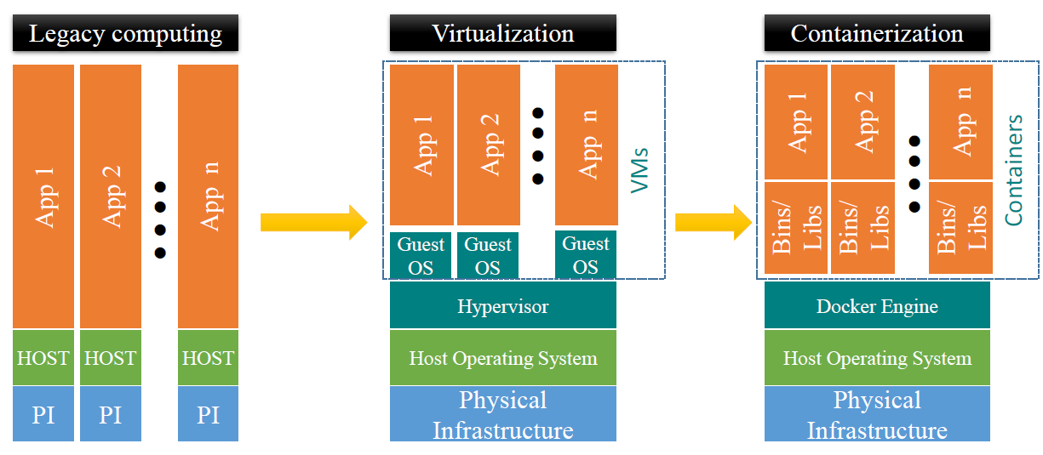
Containerization
Containerized apps share Host OS’s kernel to execute work
Workload in Containers use Host OS kernel
What we need
Lightweight
Require less memory space
Fast lunch time
better resource utilization
1000s of containers can be loaded onto a Host

Slide 13
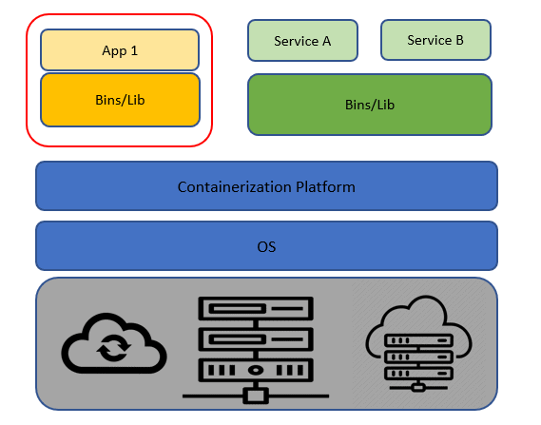
Containerization

Slide 14
Containers
What is a container?
Containers are lightweight packages of your application code together with dependencies such as specific versions of programming language runtimes and libraries required to run your software services.
Containers make it easy to share CPU, memory, storage, and network resources at the operating systems level and offer a logical packaging mechanism in which applications can be abstracted from the environment in which they actually run.

Slide 15
Containerization Benefits
Ease of Deployment
Containers are built and deployed from a local image in only a few seconds.
Scalability and Flexibility
Containerized applications are perfect for scaling both up and down.
Consistent
Since containers are standardized units, they will work in any provided environment.

Slide 16
Containerization Benefits
Portability
Not tied to or dependent upon the host operating system.
Agility
Capability to manage various kinds of changes quickly during the development process.
Security
due to isolation of applications.

Slide 17
Why Do We Need Containers?

Slide 18
Why Do We Need Containers?
The main advantage of containers is that they are lightweight and portable and thus helps the developer a lot in configuring and deploying their application.
There are many reasons for using Containers but only some of them are listed below:
Lightweight: Share the machine OS, they don’t need a full OS instance per application.
Portable: A package having all their dependencies with them, write the software once and run across different computing environments.
Supports CI/CD: Deployment portability/consistency across platforms and their small size.
Improves utilization: Enable developers and operators to improve CPU and memory utilization.

Slide 19
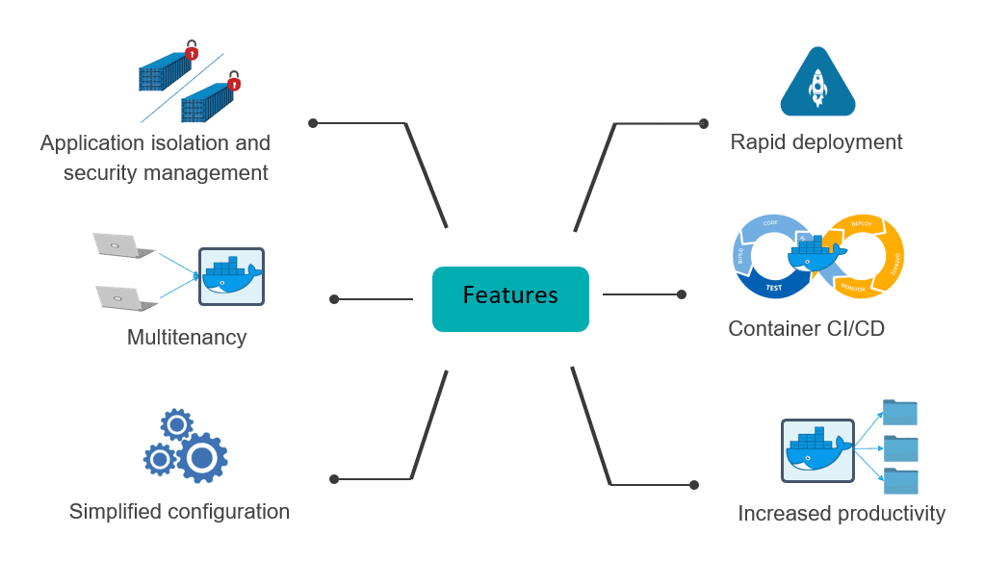
Common Features of Containers

Slide 20
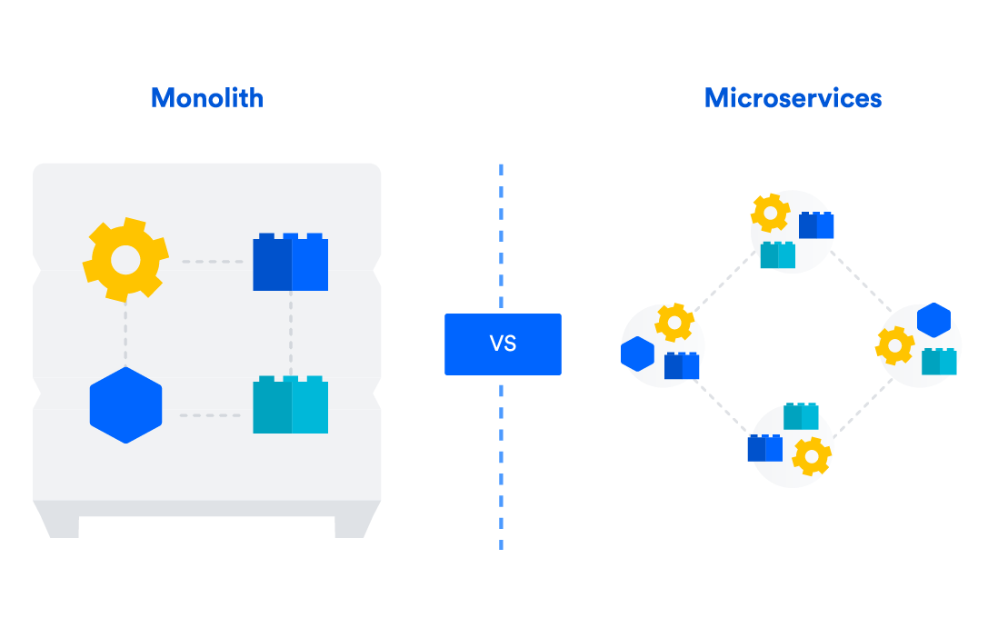
Monolithic vs Microservices Architecture

Slide 21
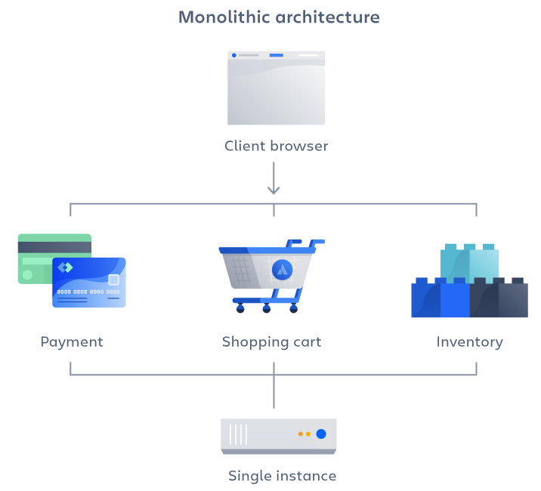
Monolithic vs Microservices Architecture
A monolithic architecture is built as a unified unit that is self-contained and independent from other applications.
The word “monolith” is often attributed to something large.
A monolithic architecture is a singular, large computing network with one code base that couples all of the business concerns together.

Slide 22
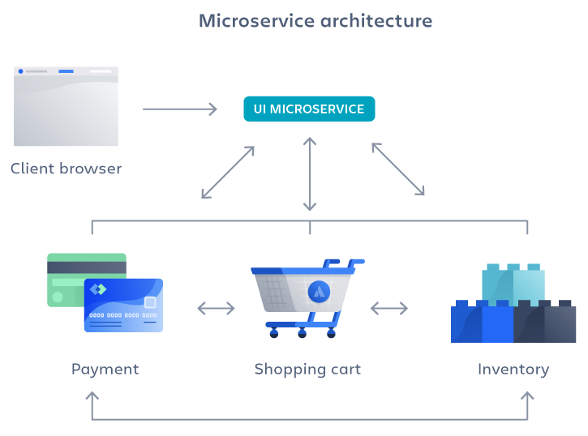
Monolithic vs Microservices Architecture
A microservices architecture is an architectural method that relies on a series of independently deployable services.
These services have their own business logic and database with a specific goal.
Microservices decouple major business, domain-specific concerns into separate, independent code bases.

Slide 23
What is Microservices?
Microservices is an architectural style that organizes an application as a group of smaller services instead of a single bulky service.
Moreover, these smaller services have the following behavior:
Loosely coupled
deployable independently as a single entity
Highly maintainable and testable

Slide 24
What is Microservices?
These services need smaller team for development and they are perfectly organized around business capabilities.
Practically, We divide a big application into smaller modules(services).
However, the implementation of each module happens as a single application.
When integration of all services(modules) takes place, the complete application architecture is known as Microservices.
In simple words, Microservice is all about distributing or breaking a large application into small pieces(services).

Slide 25
Microservices Architecture
Microservice Architecture is a “particular way of designing software applications as suites of independently deployable services“.
Applying microservices architecture means separating out business functionality into multiple independent modules that are independently responsible for performing specifically described, standalone tasks.
These modules communicate with each other through simple, globally accessible application programming interfaces (APIs).

Slide 26
Benefits of Microservices Architecture
Offers high flexibility for changes.
If one Microservices is not working properly then it may not affect all other services.
Modification, Upgrade, Enhancements to new technologies are not so complex as it is in Monolithic architecture.
If the number of Microservices increase, the code will never become complex.

Slide 27
Benefits of Microservices Architecture
Scaling Service is easy, as Microservice architecture enables each service to be scaled independently.
It makes continuous deployment possible for complex applications as it offers each microservice to be deployed independently.
It provides a choice of adopting new technologies in between the development instead of making choices at the start of the project.
The possibility to replace small parts of the system easily, in case if any part is unreliable or client demands it to replace.
Easy to integrate with new systems and external sources via an API.

Slide 28

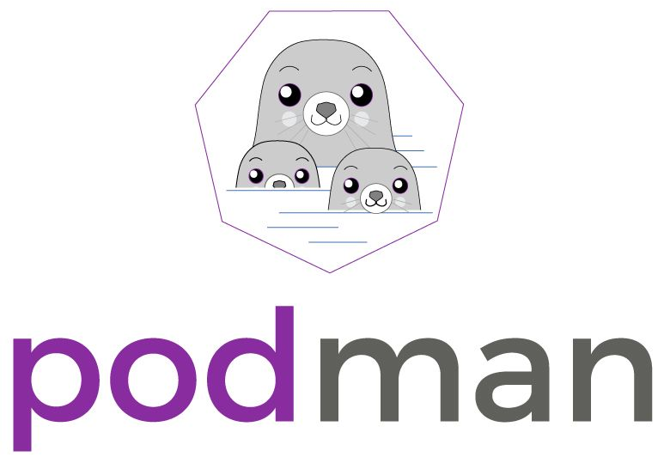


Container Tools

Slide 29
Why we need Docker?

Slide 30



Problems before Docker
An application works in developer’s machine but not in testing or production
This is due to difference in computing environment between Dev, Test, and Prod
Code works on my machine
There is some problem with the code
Development
Production

Slide 31
Problems before Docker
The idea behind microservices is that some types of applications becomes easier to build and maintain when they are broken into smaller, composable pieces that work together
Account Service
Account DB
Online Shopping Service
Product catalog
Product DB
Imagine an online shop with separate microservices for user accounts, product-catalog order processing, and shopping cart
Cart Service
Cart DB
Order Service
Order DB

Slide 32
Problems before Docker
Developing an application requires starting several microservices in one machine.
If you are starting five of those services, you are require five virtual machines.
Virtual Machines for starting multiple services
Host Machine

Slide 33
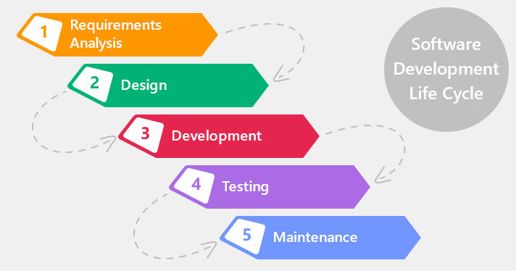
How Docker Solves these problems
You can run several microservices in the same VM by running various Docker containers for each microservice
Provide a consistent computing environment throughout the whole SDLC
Docker Containers
Virtual Machine
Host Machine

Slide 34

What is Docker?

Slide 35
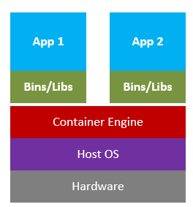
What is Docker?
Docker is a tool designed to make it easier to create, deploy, and run applications by using containers.
Docker containers are lightweight alternatives to Virtual Machines and it used the host OS.
You don’t have to pre-allocate any RAM in containers.

Slide 36
Docker in a Nutshell
Docker files builds a Docker image and that image contains all the project’s code
You can run that image to create as many Docker containers as you want
This image can be uploaded on Docker hub, from Docker hub any one can pull the image and build a container.
Container
Staging Server
Container
Docker File
Docker Hub
Image
Container
Docker Image
Docker Container
Container
Production Server
Container
Virtual Machine
Image
Container

Slide 37
Docker Example

Slide 38

Docker Example
Docker File
Git Repo
Jenkins Server
Testing
Complex requirements for a microservice are written in easy to write Docker file
Push the code to Git Repo
Staging
Production
Create complex requirements for a microservice within an easy- to-write Docker File
Push the code the Git Repository
CI server pull it down and build the exact environment that will be used in production to run the test suite without needing to configure the CI server at all.
Deploy it out to a staging environment
Roll exactly what you had in development, testing, and staging into production

Slide 39
3 Myths about Docker
Docker is all-or-nothing
Many SMEs tend to believe that they have to use Docker to evolve the apps’ entire architecture.
However, that is not the case as Docker is compatible with simple and complex Apps, given you isolate APIs and necessary web services.
Without the cloud, Docker cannot be implemented
Cloud services are the talk of the day in terms of automation, storage, development, and whatnot.
There is no mandatory requirement that indicates that your app should be on the cloud to use Docker.
Docker offers various benefits with cloud services, but the requirement of your app comes first.
Just because it provides a virtualized OS, it does not mean you have to migrate towards the cloud.
Security concerns with Docker is high
With the security concerns that come with Virtual Machines (VMs), many businesses falsely believe that Docker is prone to security breaches or is inherently insecure.
Though that may have been true in the past, currently, Docker uses Kernel-level security via virtualized servers. Therefore, Docker is secure as any other platform can be!

Slide 40
Docker Case Study

Slide 41
Docker Case Study (Indiana University)
Problem Statement
1
2
Their environment was optimized for their legacy Java-based applications
VM
Custom Scripts
VM
VM
Applications are deployed in the VMs using scripts

Slide 42
Docker Case Study (Indiana University)
The university wanted to improve the way they architect applications, by moving to microservices based architecture
Problem Statement
3
UI
UI
Business Logic
Microservice
Microservice
Microservice
Data Access Layer
Database
Database
Database
Database
Monolithic Architecture
Microservice Architecture

Slide 43

Docker Case Study (Indiana University)
Security was needed for student’s data
Problem Statement
4

Slide 44
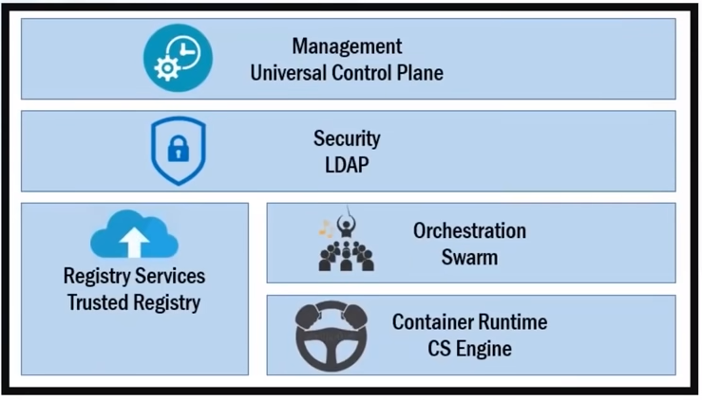
Docker Case Study (Indiana University)
Solution: Docker Data Center (DDC)

Slide 45
Docker Case Study (Indiana University)
Solution: Docker Data Center (DDC)
Helps in managing whole cluster from one place. Servers are deployed using UCP web UI, using Docker images that are stored in DTR
Host A
IT operations teams leverage Universal Control Plane to provision Docker installed software on hosts, and then deploy their applications without having to do a bunch of manual steps to setup all their infrastructure
Docker Trusted Registry
UCP Web UI
Host B
Host C
Stores the Docker images
The role-based access controls within DDC allows them to define the level of access their user have i.e. like read-only access to their containers in production

Slide 46
Docker Uses Cases
1) Healthcare
National Institutes of Health (NIH) have been using containerization technology, especially Docker, for its mobility and flexibility in delivering imaging software services to more than 40 hospitals in the US.
It also uses Docker to curate data from different websites and integrates it with Artificial Intelligence (AI) to help doctors make informed decisions.
NIH leverages Docker to use containers to test new imaging technologies in the hospital sector. It also allows it to implement continuous integration and testing practices with all hospital collaborators and ensure that the latest technologies are used.

Slide 47
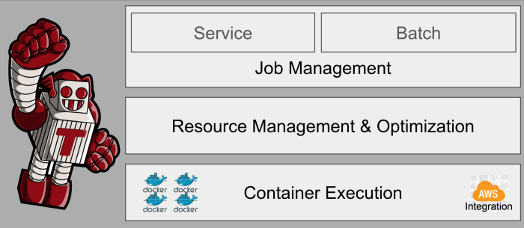

Docker Uses Cases
2) Media and entertainment
Netflix is using Docker to create its own infrastructure to execute deep functions with its integrated Amazon EC2 services. This project was called Titus.
Docker was used in Titus to specifically help with deployment and serve as a job scheduling system.
Titus helps create sophisticated infrastructure at a fast rate, assisting developers in specifying the exact code and dependencies required.
Combining Linux and Docker, helped implementing multi-tenant isolation.

Slide 48

Docker Uses Cases
3) Travel
Carnival Corporation is a British-American cruise operator controlling more than 100 vessels.
To digitize various operations and transform the experience, The MedallionClass, deployed more than 300 services across a cruise ship via this program built with Microservices Architecture.
This MedallionClass program uses a hybrid cloud infrastructure, and with the help of Docker, they were able to deploy services to any ship and also run them to improve the guest experience at any given time.
Docker helps to connect various elements such as food, beverages, accommodation, transportation, etc., on its cruise ships. Ultimately this serves to imitate each cruise ship as a mobile city.

Slide 49

Docker Uses Cases
4) FinTech
Knowis is a digital banking solution provider.
It undertook the steps to migrate away from monolithic to modernized architectures that support container technologies.
Creating a scalable application infrastructure to satisfy expanding banking markets is often the primary goal for banking sectors.
Using Docker, Knowis is able to react flexibly to the market requirements and balance the workload as well.

Slide 50

Docker Uses Cases
5) eCommerce
Alibaba Cloud provides cost-efficient possibilities for startups and Small and Medium Businesses (SMBs) to create eCommerce websites.
It allows developers to use Docker to run as many containers as needed instantly and simultaneously process various operations in a given website in a short time.
Moreover, it can be integrated with Magento CMS to manage content in the website as per the business vision.

Slide 51

Docker Uses Cases
6) Education
Wiley Education Services (WES) provides online educational services to more than 60 higher educational institutions.
It aims to connect higher education partners, and in this process, the development team leverages multiple technologies.
Docker has helped it innovate and experiment with creating architecture with room for scaling.
The foremost benefit, Dockers, brings to the WES table is the ability to get one of its websites up and running in the marketplace in no time helping connecting students with partners faster.

Slide 52
Docker use cases for businesses
1) Adoption of DevOps
2) App infrastructure isolation
3) Multi-tenancy support
4) Improvement in software testing
5) Smart Disaster Recovery (DR)
6) Continuous rapid deployment

Slide 53
Docker use cases for businesses
7) Creation of microservices architecture
8) Migration of legacy apps to containers
9) Simplification of code configuration
10) Management of development pipeline
11) Increased developer productivity
12) Consolidation of server requirements
13) Porting across cloud providers

Slide 54
When not to use Docker?
Product is desktop app
Docker is best for current web apps since it requires server-based software.
Project is simple and small
Docker is helpful to keep track of dependencies and multiple functions with vast architecture.
Development pipeline involves multiple Oss
Docker can run natively on Linux and Windows by default today and supports running on macOS.
Containers created use the host system’s kernel, and there is no possible way to create a container that uses a different kernel on another system.
Requirement is to only boost app performance
Docker eases development processes and increases productivity.
Project needs easily managed technology
Docker is still a new technology and many enterprises struggle to understand it and focus on how it is well connected with DevOps, Cloud services, and Microservices.

Slide 55
Docker Components

Slide 56
Docker Architecture
The client allows to run various Docker commands (installed in any OS).
The registry is place to find and download Docker images.
The docker host is the server running the Docker daemon.

Slide 57
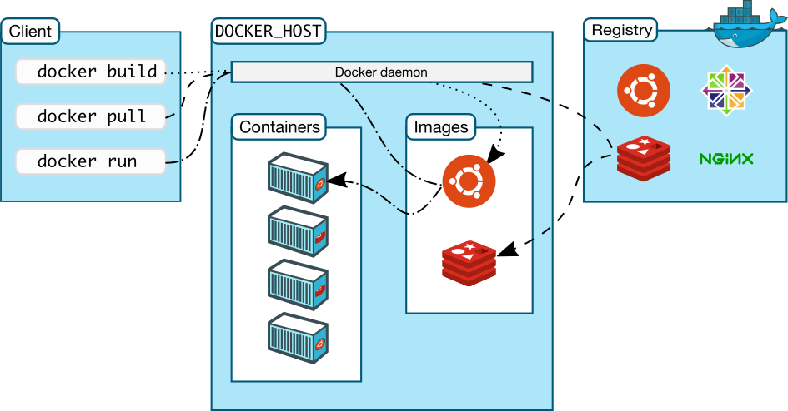
Docker Components
Docker Client
Command Line Interface (CLI)
Docker File
Text file instructions
Image
Hierarchies of files built from Docker File
Container
Running instances of an image
Registry
Image repository

Slide 58

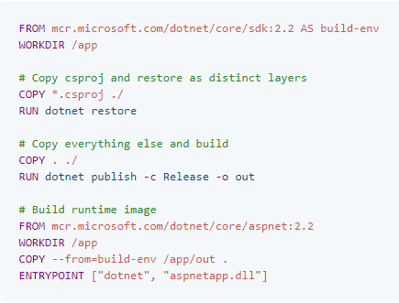
Docker Components
Docker Container
Docker Image

Slide 59
Basic Docker Commands
$ docker image pull node:latest
$ docker image ls
$ docker container run –d –p 5000:5000 –-name node node:latest
$ docker container ps
$ docker container stop node(or <container id>)
$ docker container rm node (or <container id>)
$ docker image rmi (or <image id>)
$ docker build –t node:2.0 .
$ docker image push node:2.0
$ docker --help

Slide 60
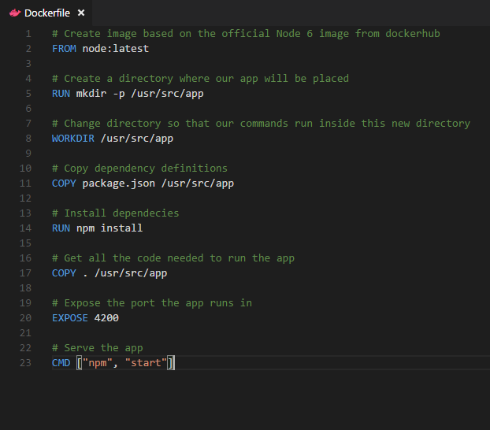
Dockerfile – Linux Example
Instructions on how to build a Docker image
Looks very similar to “native” commands
Important to optimize your Dockerfile

Slide 61

Docker Registry
Docker Registry is a storage component for Docker images
We can store the images in either Public/Private repositories
Docker Hub is Docker’s very own cloud repository
Why use Docker Registries?
Control where your images are being stored
Integrate image storage with your in-house development workflow

Slide 62
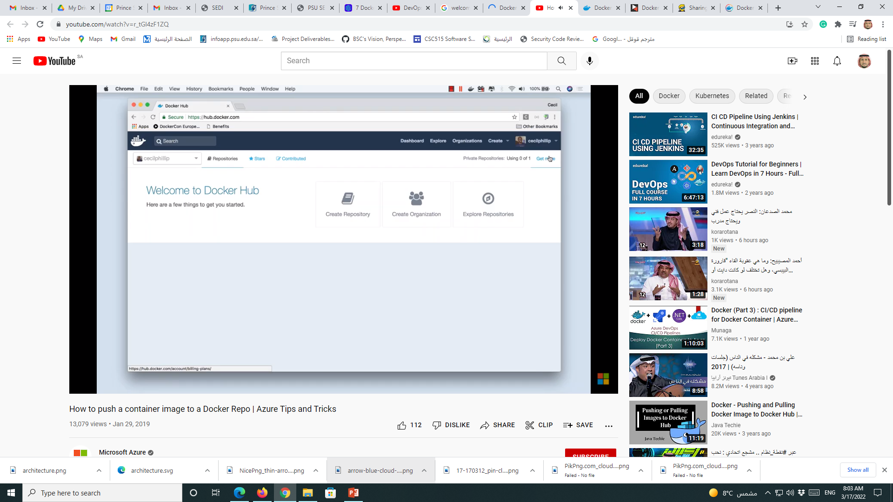
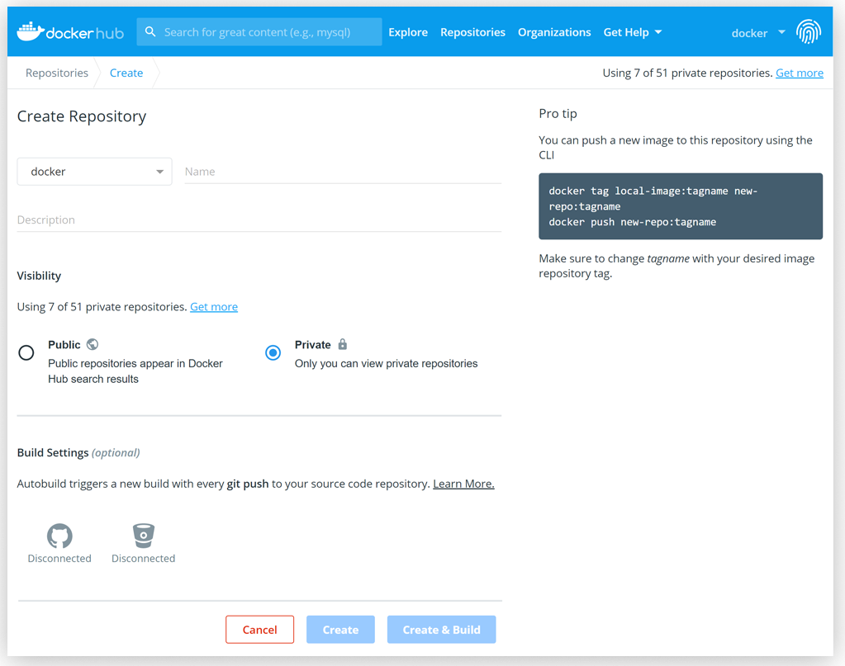
Docker Hub
Docker Hub is a service for finding and sharing container images with your team and the Docker community.
Key features
Explore the world’s largest container image repository
Share and store images in public or private repositories

Slide 63
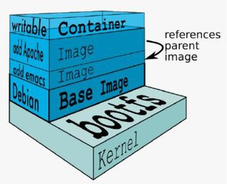
Docker Image
An image is a collection of files and some meta data
Images are comprised of multiple layers
Each image contains software you want to run
Every image contains a base layer
Layers are ready only

Slide 64
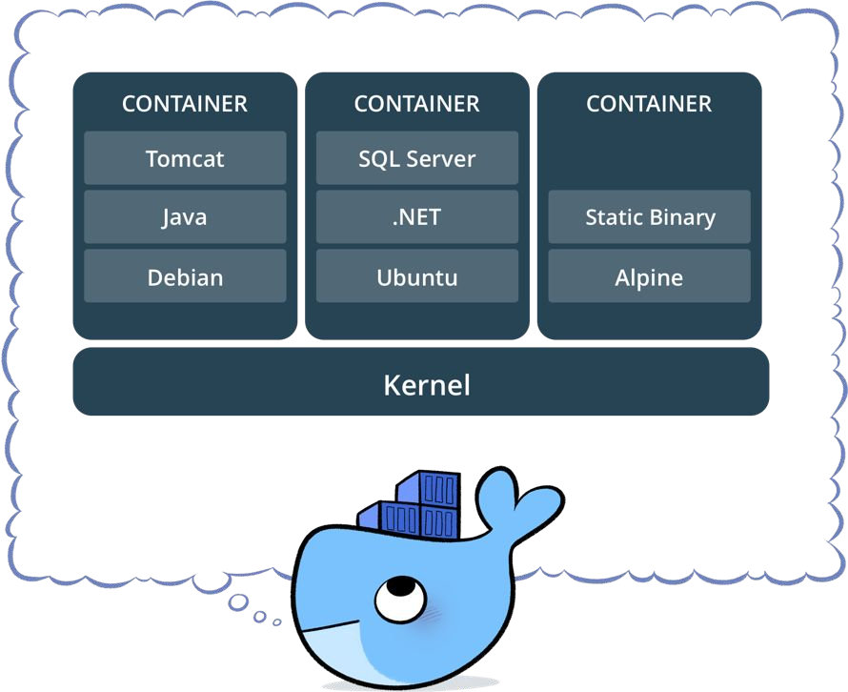
Docker Container
Standardized packaging for software and dependencies
Isolate apps from each other
Share the same OS kernel
Works for all major Linux distributions

Slide 65
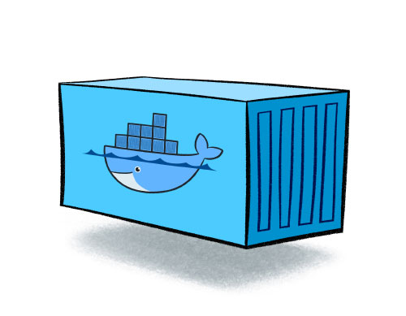
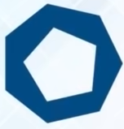
Docker Images and Containers
run
Docker Image
Docker Container
Read Only Template used to create Containers
Built by Docker Users
Stored in a Docker Hub or your local Registry
Isolated Application Platform
Contains everything needed to run the application
Built from one or more images

Slide 66
Basic Docker Commands

Slide 67
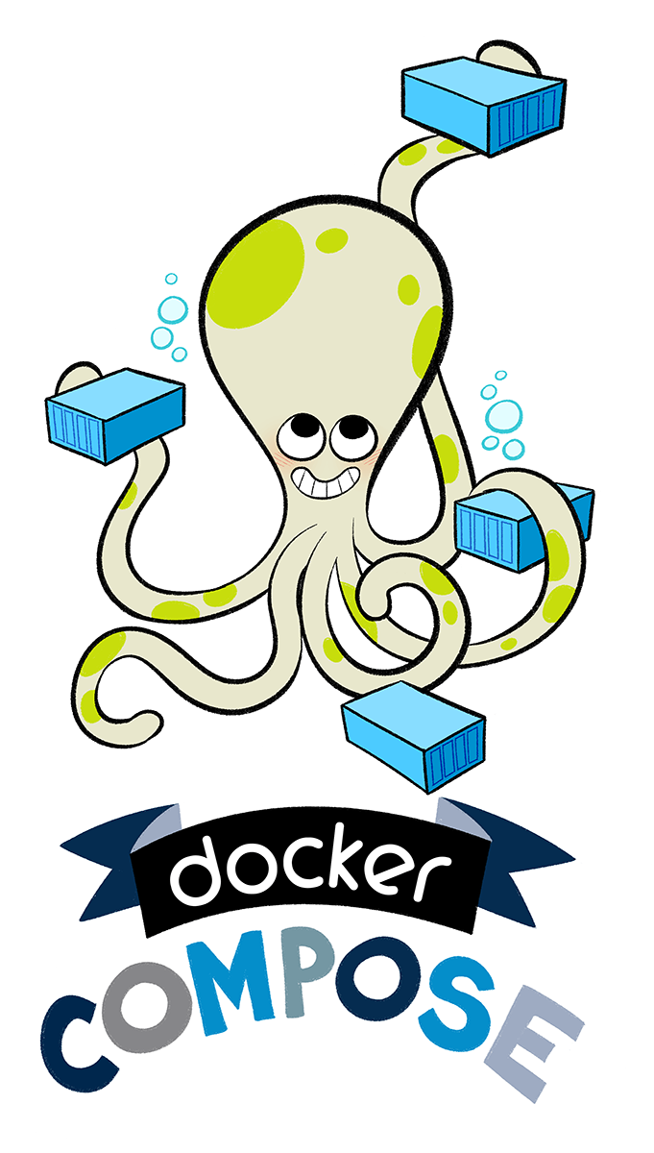
Docker Compose
Docker Compose is a tool for defining and running complex applications with Docker.
Define a multi-container application in a single file
Spin your application up in a single command

Slide 68
Docker Compose
Features
Multiple isolated environments on a single host
Preserve volume data when containers are created
Only recreate containers that have changed
Variables and moving a composition between environments
Multiple compose files

Slide 69
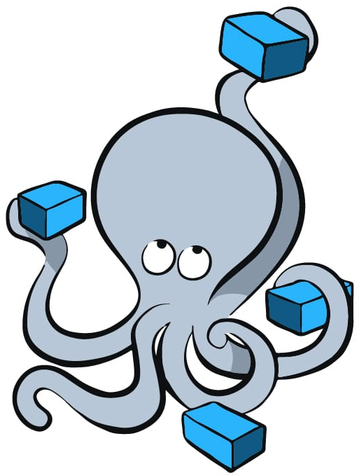
Docker Compose
Docker Compose make it easier to configure and run applications made up of multiple containers. For example, imagine being able to define three containers-one running a web app, another running postgres, and a third running redis-all in one YML file and then running those three connected containers in a single command
Web App
Docker Compose File
You can run these three containers with a single command
Containers
Postgres
Redis

Slide 70
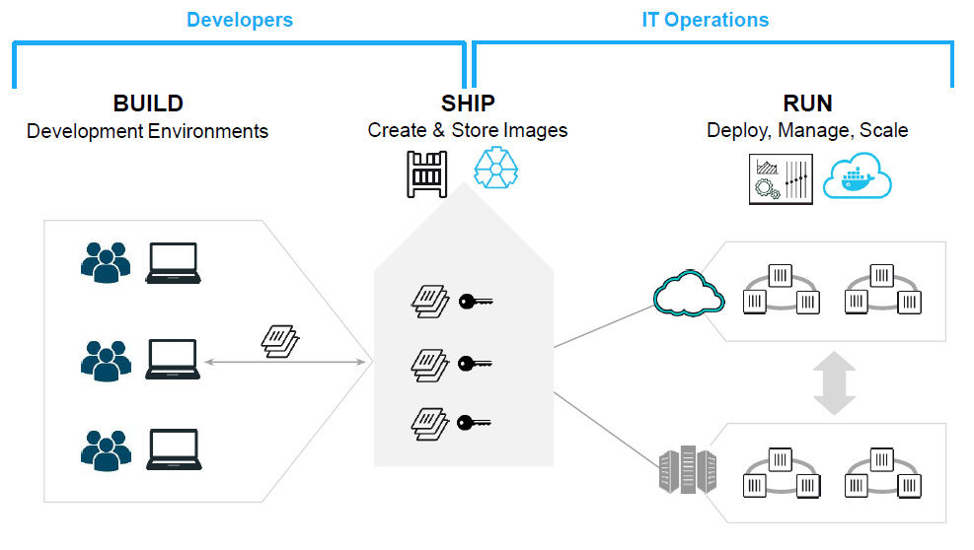
Docker – in DevOps

Slide 71
YAML File
YAML Ain't Markup Language (YAML) is a human-friendly data serialization language for all programming languages.
It's often used as a format for configuration files, but its object serialization abilities make it a viable replacement for languages like JSON.
It is commonly used for configuration files and in applications where data is being stored or transmitted.
Latest version (YAML 1.2.2 on October 2021)

Slide 72
YAML File
Version
Services
Build
Image
Environment
Ports
Volumes
Volumes
Networks
YAML files are most commonly used as configuration files, which define a program or application's settings.
version: '3'
services:
jenkins:
image: jenkins/jenkins:lts
ports:
- “8080:8080”
- “50000:50000”
artifactory:
image: docker.bintray.io/jfrog/artifactory-oss:latest
ports:
- 8081:8081

